Slide 1
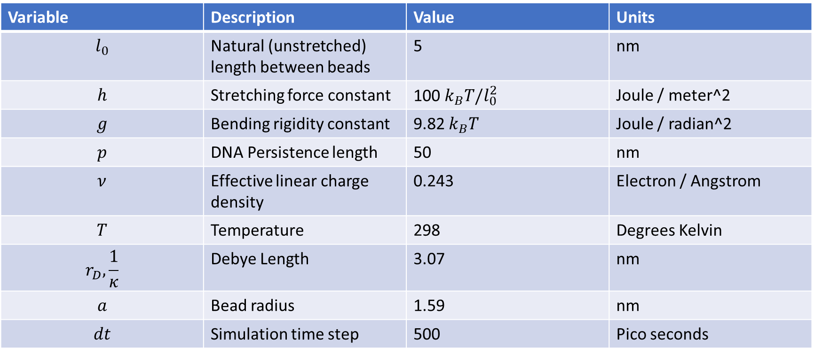
Simulation parameters
Variable | Description | Value | Units
$$l_{0}$$ | Natural (unstretched) length between beads | 5 | nm
$$h$$ | Stretching force constant | 100 $k_{B}T/l_{0}^{2}$ | Joule / meter^2
$$g$$ | Bending rigidity constant | 9.82 $k_{B}T$ | Joule / radian^2
$$p$$ | DNA Persistence length | 50 | nm
$$ν$$ | Effective linear charge density | 0.243 | Electron / Angstrom
$$T$$ | Temperature | 298 | Degrees Kelvin
$$r_{D},\frac{1}{κ}$$ | Debye Length | 3.07 | nm
$$a$$ | Bead radius | 1.59 | nm
$$dt$$ | Simulation time step | 500 | Pico seconds

